Slide 1



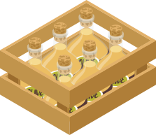



TILL PLANT SYSTEM FOR COTTON CROP
Mk Campaign
AG31201 - DESIGN OF FARM MACHINERY

Slide 2


GROUP MEMBERS
20AG10040 - VANUMU PRANEETA
20AG30040 - YASH KUMAR SANTOSHI
20AG3EP10 - YOGENDER ARYA
20AG10029 - Peerzada Mohammed Rabet

Slide 3
MECHANICAL DESIGN APPROACH
1.
Objective and Purpose of the Machine
2.
2.
Derivation of functional needs
3.
Approximate kinematic design
3.
4.
Functional design analysis and approximation
5.
DYNAMIC ANALYSIS
6.
Ergonomics

Slide 4
Objective and purpose of the machine
Minimum tillage must be followed by simultaneous ridging.
Seeds should be placed in the soil at regular row to row and hill to hill spacing.
One seed should be placed in one hill.
The planter must have precise seed metering system for proper spacing of crop.

Slide 5
Derivation of functional needs
Minimum tillage must be done maintaining the strip width of 20 cm followed by simultaneous ridging to form ridges at 40 cm width. This ensures the 60 cm row to row spacing.
Seeds should be placed in the soil at regular row to row and hill to hill spacing. One seed should be placed in one hill.
The seeds should be picked up from the hopper one-by-one and sent it for placement.
Proper depth of placement must be maintained. Open the soil to a constant depth and place the seed and cover the seed with the soil by putting back the soil.

Slide 6
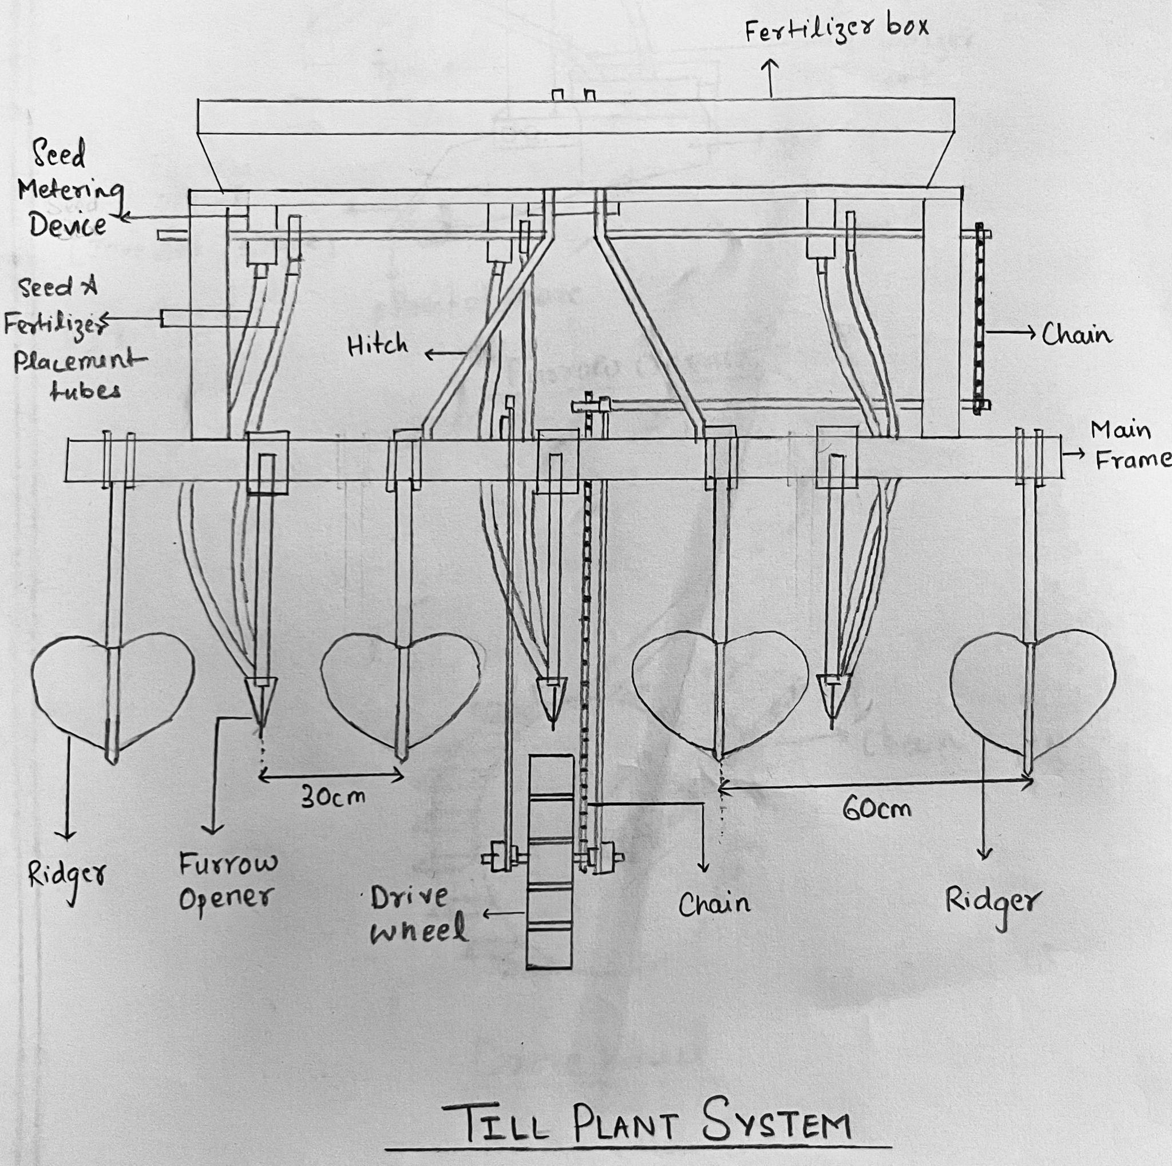
Functional design
Seed box

Slide 7
Functional design, analysis and approximation
Functioning
Theoretical analysis and calculation
Agrotechnical requirements
Units of till plant system equipment:
Hopper
Seed metering and delivery system
Inverted T type furrow opener
Drive Wheel
Seed Dimensions:
Cotton seed size is 3.5-10 mm on an average.
Cotton seed weight is 100 mg/seed on an average.

Slide 8
Seed Box
Functioning:
The seed box is used to hold the bulk of seeds and periodically send the seeds for placement in the hills.
Theoretical analysis and calculations:
Volume of hopper = Weight of Seed / Bulk Density of seed (Bulk density of cotton = 575 kg/m^3)
Vs (Volume of seed box with respect to dimensions) = ½ (a+b)*h*l
Agrotechnical requirements:
Mild steel sheet (2 mm thick) is preferred due to its high durability.
The cross section of the seed box is trapezoidal.

Slide 9
Seed Metering device
Functioning:
The aim of the metering device is to put one seed in one hill. The seed metering device facilitates this purpose.
The type of seed metering device used is inclined belt type.
Theoretical analysis and calculations:
The size of the holder is a little bit bigger than the average size of the cotton seed (> 10 mm ).
The number of holders is designed based on the size of the metering device.
Agrotechnical requirements:
A constant speed of tractor must be maintained.

Slide 10
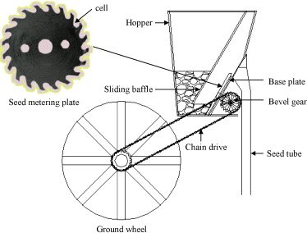
Seed Metering device

Slide 11
Inverted t type furrow opener
Functioning:
The inverted T type furrow opener penetrates the tilled soil into the strip till furrow, to make furrows and place the seed at the desired depth, ensuring better seed coverage in the strip.
Theoretical analysis and calculations:
A 4 cm wide, 5 cm thick and 6 cm long stiffener plate is provided at back bottom of the inverted T-type furrow opener (5.0 × 1.2 cm) which is attached to the frame with nuts and bolts.
The depth of the sowing of seeds must be 4-5 cm.
Agrotechnical requirements:
The cutting portion of furrow openers (point of share) is made of 8 mm thick high carbon bit welded to a mild steel plate.

Slide 12
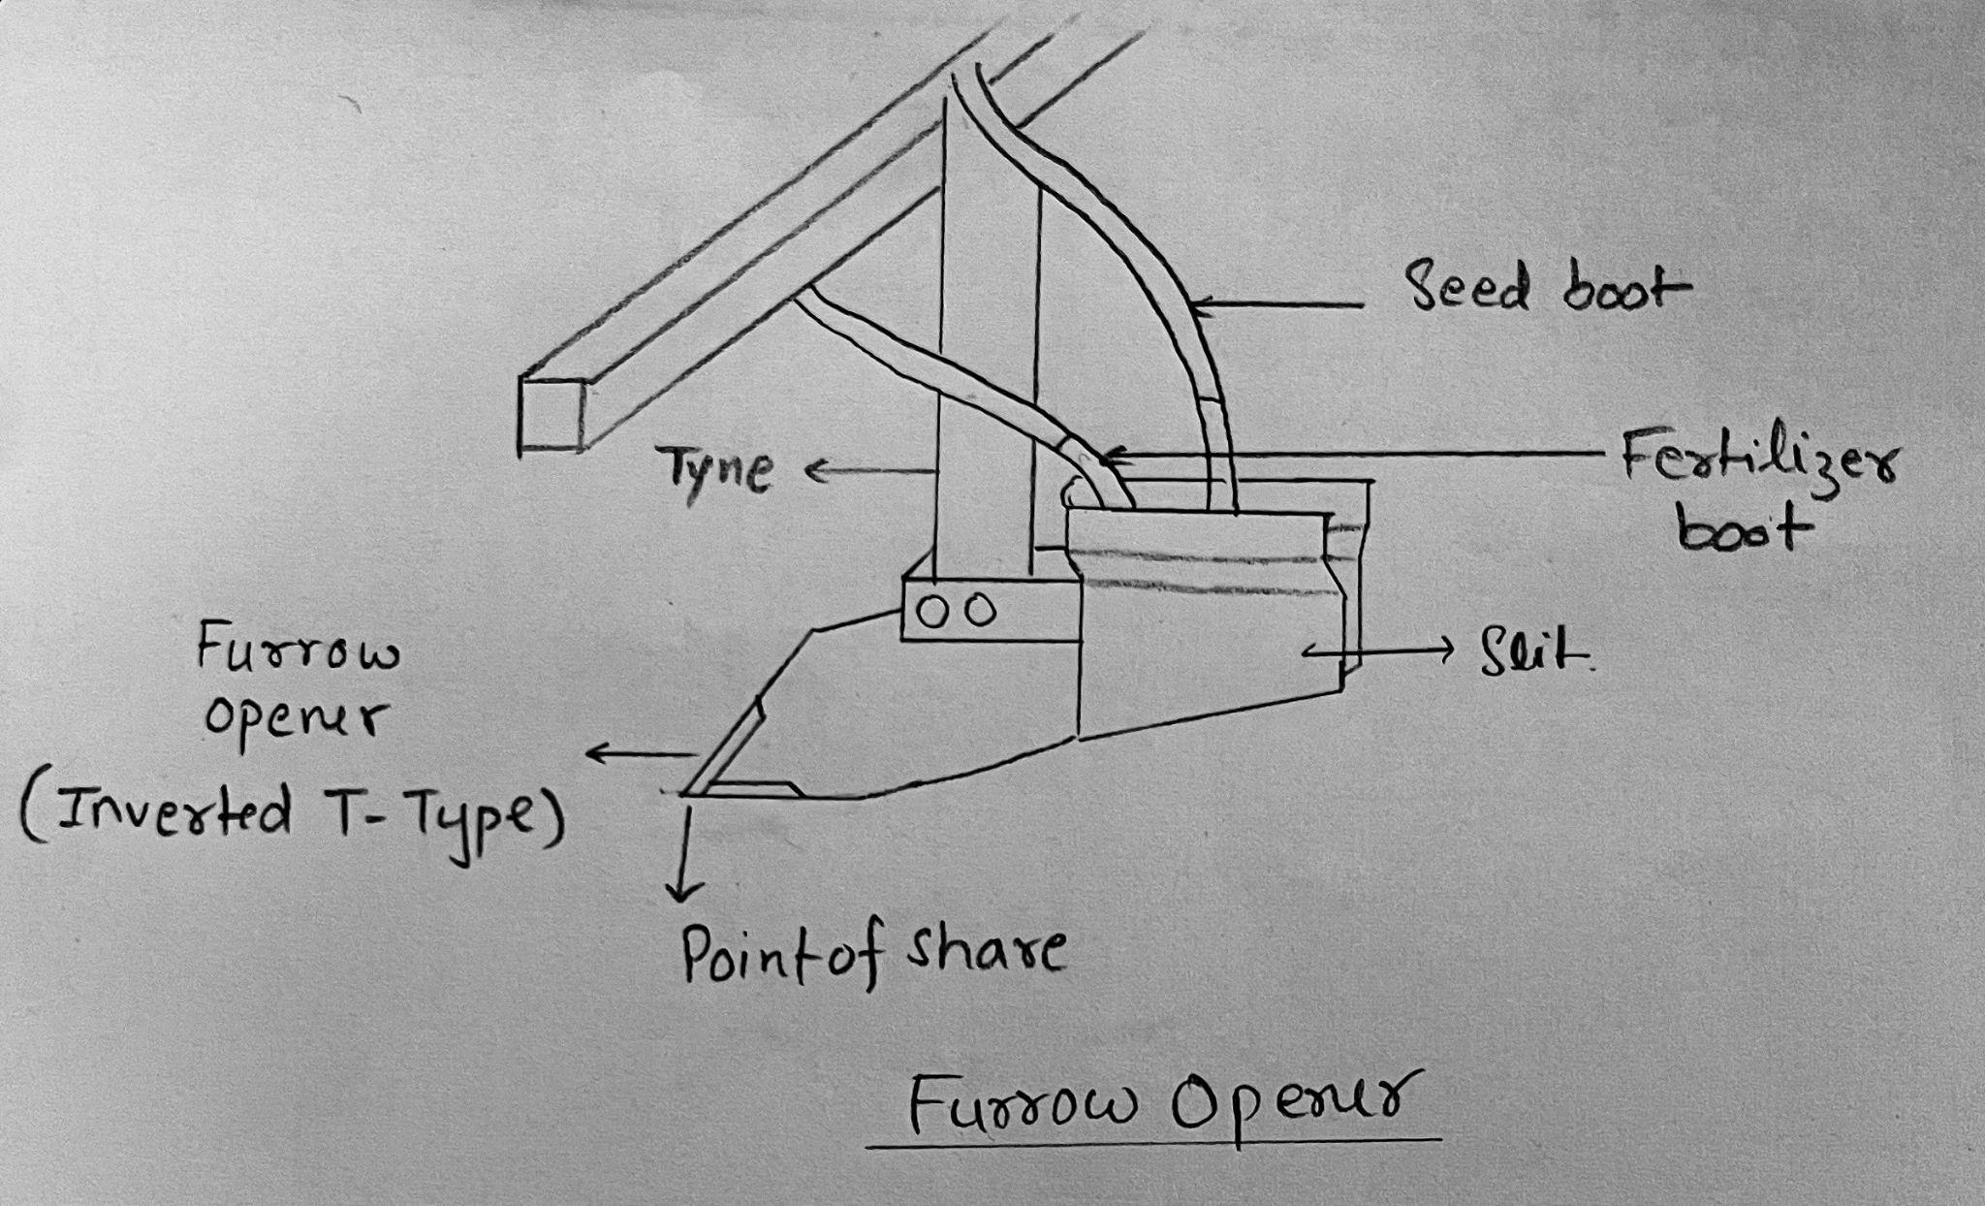
Inverted t type furrow opener

Slide 13
Drive wheel
Functioning:
The function of drive wheel is to transmit power to the seed and fertilizer metering gears.
Theoretical analysis and calculations:
The diameter of the drive wheel in the multi-crop planters is 25 to30 cm.
Agrotechnical requirements:
Chains are attached to the drive wheel and to the driving shaft.
There are lugs on the circumference of drive wheel to avoid or minimize slippage.

Slide 14
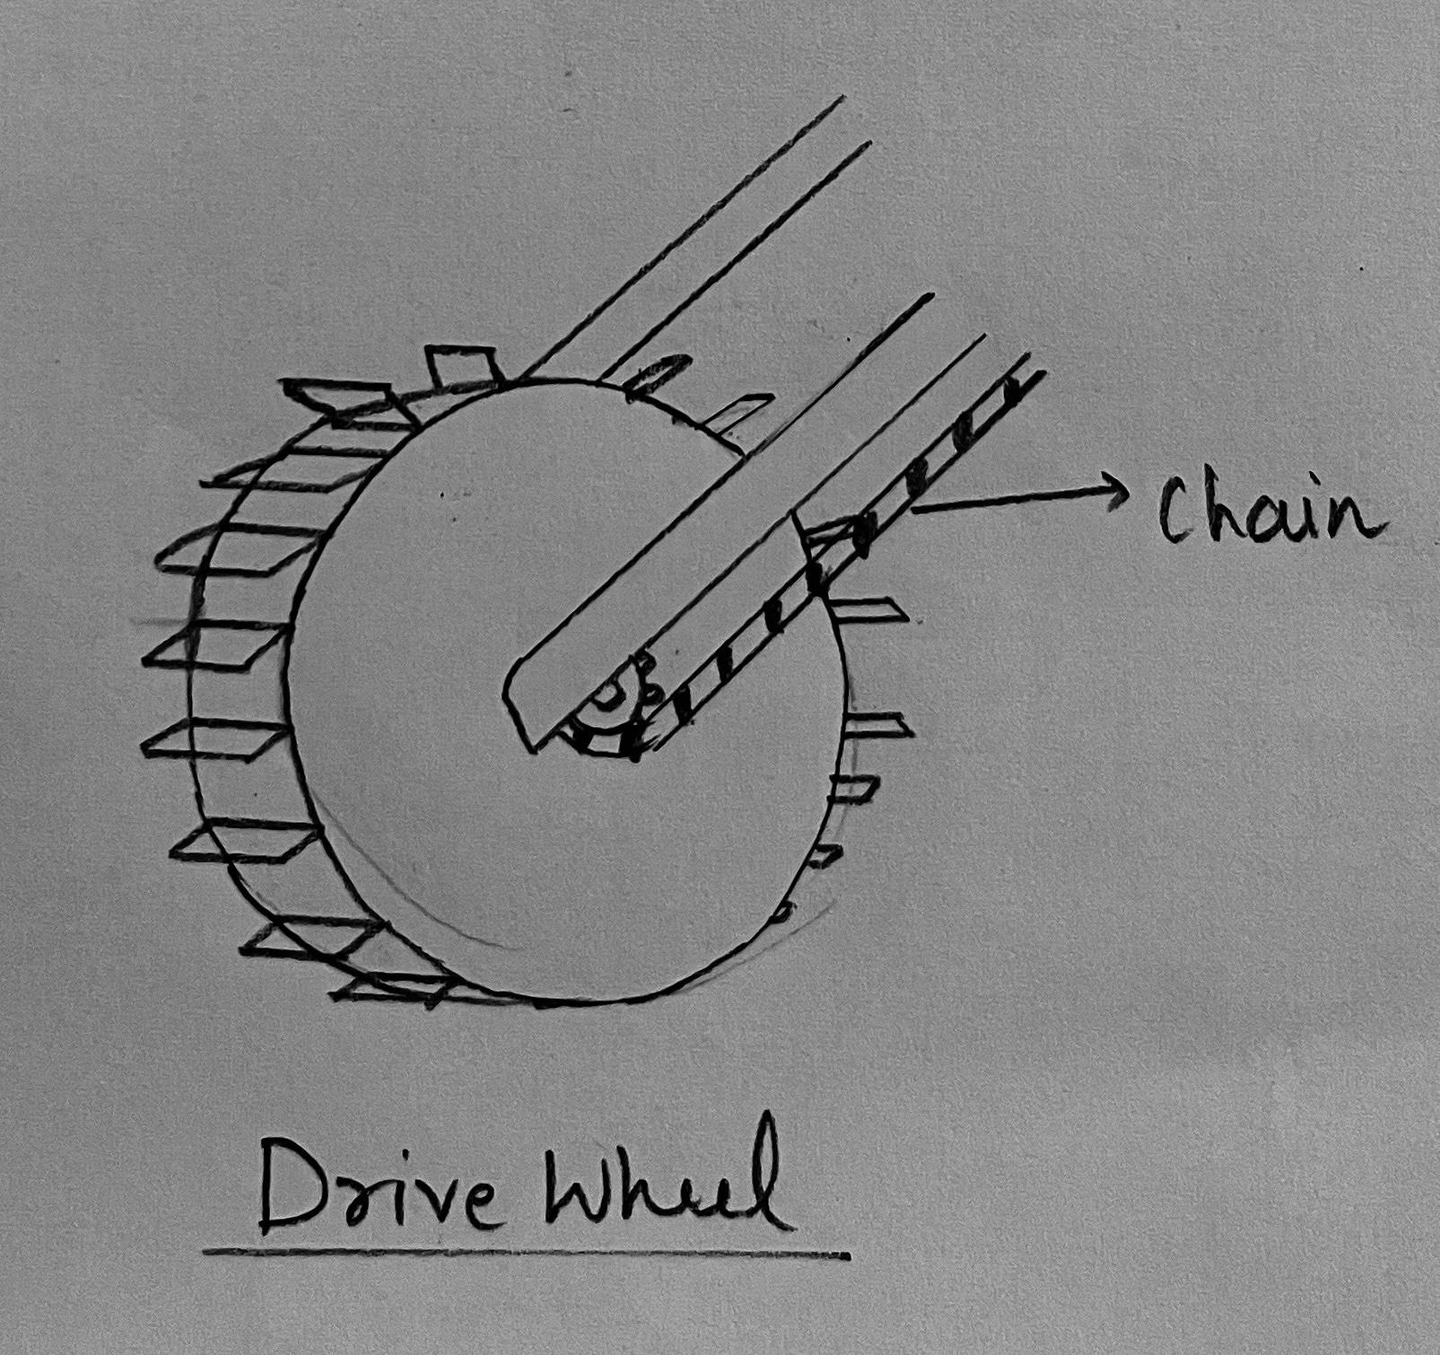
Drive wheel

Slide 15
Dynamic Analysis
Mechanism:
As the ground wheel moves by the force generated by the tractor, the ridgers rearrange the soil into hills with 60 cm spacing between each consecutive peaks and simultaneously the inverted T type furrow opener penetrates the tilled soil into the strip till furrow, to make furrows and place the seed at the desired depth, ensuring better seed coverage in the strip.

Slide 16
Dynamic Analysis
Theoretical analysis and calculations:
Measure circumference of drive wheel (Cd). Measure width of the drill (Wd),
Seed rate (kg/ha) = {Sw/(Cd × Wd)}
Where Sw = Total weight of seed released in 10 Revolution (g)
Cd = Circumference of drive wheel, Where Cd = 2 x π x radius
Wd = Width of the machine (m).
Actual field capacity of the drill(ha/h)= speed(km/h)*working width of the drill(m)/10
Seed weight(kg) after a unit time= seed rate(kg/ha) * area covered(ha/h) *time(h)
Maximum draft force (D) = power of the tractor (P)/ forward speed (v)

Slide 17
ergonomics
The planter should be properly serviced and maintained. It should be checked before use to ensure that all the nuts and bolts are tightened and that all the parts are in good condition.
Chains should be adjusted and oiled. After use at the end of each day, the machine should be checked, the seed boxes cleaned, and the moving parts oiled.
After the planting season, the machine should be properly stored.

Slide 18
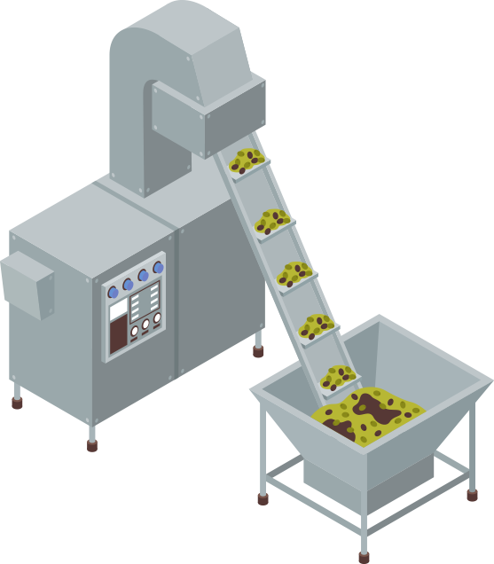

Thank You

